Slide 1

Assalamu Alaikum, Everyone!

Slide 2
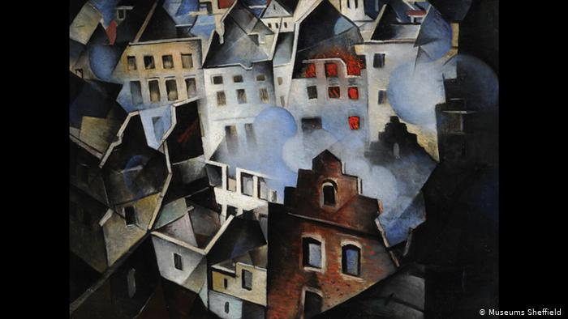

Group Members
FARIA AHMED
ID: 190041218
2. TASFIA TASNEEM ANNESHA
ID: 190041220
3.SYED FATEEN NAVID HAIDER
ID: 190041226

Slide 3
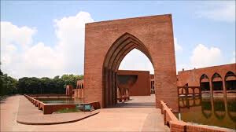


The game takes place in an area of immense greenery and beauty in a weirdly deserted Gazipur, IUT (Islamic University of Technology). The player plays as a student of IUT & the player's goal is to remain financially solvent while forcing opponents into bankruptcy by buying and developing pieces of property.
BACK STORY

Slide 4
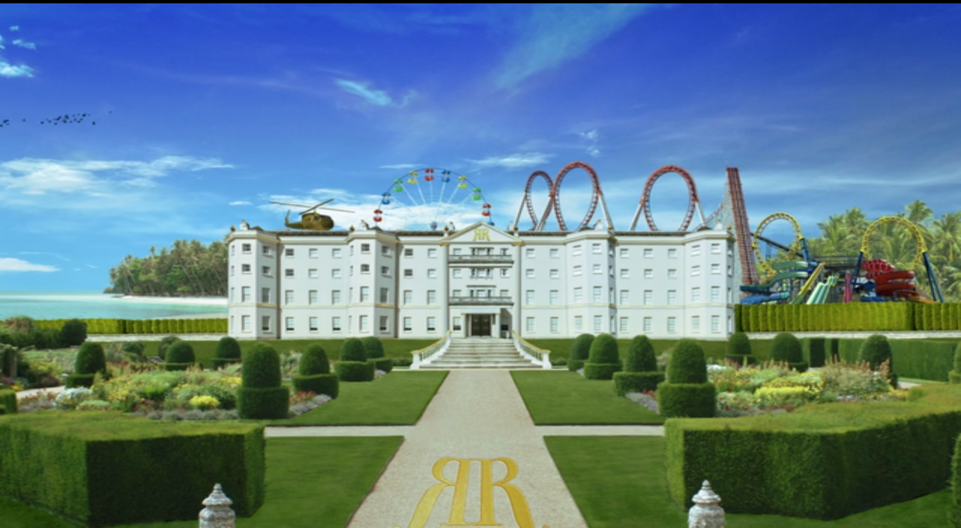

RICHIE RICH

Slide 5
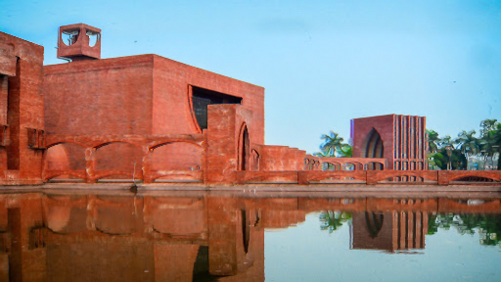
RICHIE RICH
IUT

Slide 6


BASICS
-2 DICE GAME
-2 PLAYERS
-YEARLY ALLOWANCES & CGPAS
-STARTING ALLOWANCE=20000TK

Slide 7
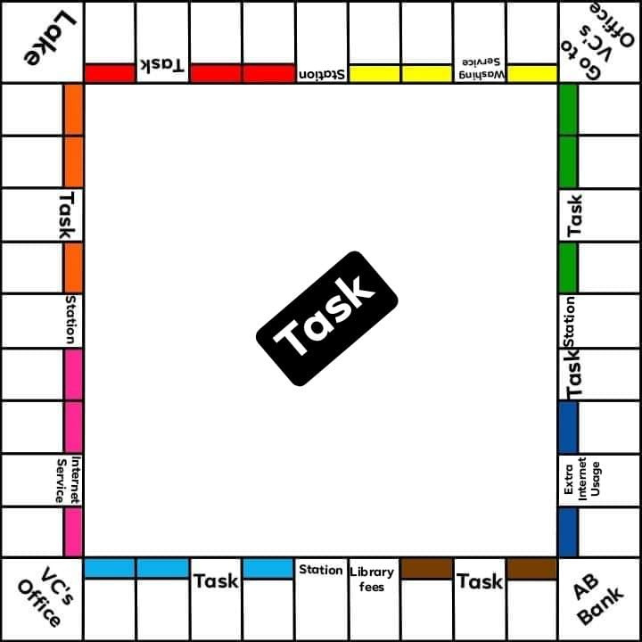

-ROLL THE DICES & MOVE
-BUYING AND BIDDING FOR PROPERTY
-PAYING RENT
-TASKS
-UPGRADING PROPERTY & REWARD
-TROUBLEMAKING
-TRADING PROPERTIES
-MAKING A FULL ROUND
Game play

Slide 8

CODE
A) WE'LL DECLARE TWO STRUCTURES-
1. For the collection of variables of a Property's information
2. For the collection of variables of a Player's information
b) We'll be using rand(), srand() for rolling the dice (which generates random number);
c) We'll be using different user defined functions for different actions (buying property, making move etc.) of the game.

Slide 9



-Adding more features, like using CGPA for buying upgrades etc.
-INCREASING THE NUMBER OF PLAYERS
- ALLOWANCE WILL BE SET BY THE PLAYERS

Slide 10

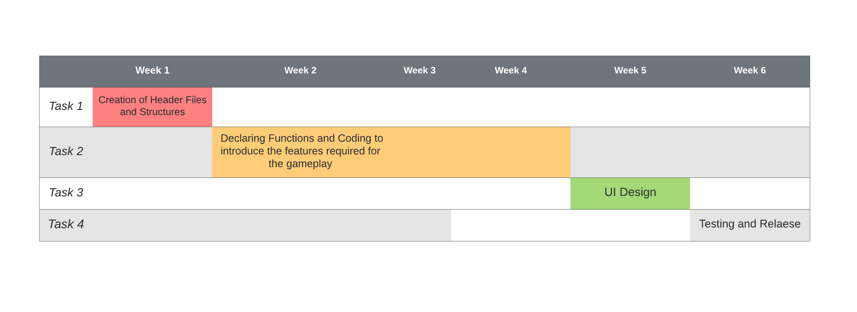
Timeline

Slide 11



